Slide 1

BACHELOR OF ENGINEERING
FINAL PRESENTATION ON
REGION WISE SALES PERFORMANCE ANALYSIS OF EMPLOYEES-A POC
Department of Computer Science and Engineering
Chitkara University Institute of Engineering and Technology
UNDER THE SUPERVISION OF:
Amrinder Singh
Submitted By:
Shivang
Tarun Jindal
Haarleen
Nancy Chabria
Amol Preet Singh
Anil Garg

Slide 2
Project Plan
Introduction
Literature Review
Problem definition
Objectives
Work Done
Results
References

Slide 3
Introduction
Today, Companies all over the globe are moving their business to online market as it widens the scope of their business in a very short period of time. Sales isn’t just about the members. It’s about understanding the numbers-how to make them grow. That means every salesperson can understand customer’s need better and faster, identifying, promising leads faster and forecast result accurately, reflecting sales performance. A sales performance analysis is a way to measure sales progress over a period of time. The analysis allow the sales team to identify weakness in the sales strategy and make changes so that we can improve the results over the next period. This analysis could be used to set realistic sales performance goals for the business.

Slide 4
Literature Review
Sales isn’t just about the members. It’s about understanding the numbers-how to make them grow. That means every salesperson can understand customer’s need better and faster, identifying, promising leads faster and forecast result accurately, reflecting sales performance. A sales performance analysis is a way to measure sales progress over a period of time. The analysis allow the sales team to identify weakness in the sales strategy and make changes so that we can improve the results over the next period. This analysis could be used to set realistic sales performance goals for the business.

Slide 5
Problem Definition:
OSM Sports is a big and a famous sports equipment sellers. It was instituted in year 2010. They have their stories all over the world. People can also buy product online .They sell sports equipment of different sports and brands. A large number of people are working with this brand at different designations and across different locations. A large number of customers buy products of this brand. If the customer find the sports equipment faulty (or any other valid reason), he/she can return it. But for the last few years, their sale is going down and hence their profit is also getting reduced. So the higher management wants to know where they need to improve. For this, they need different type of reports/balanced scorecards/dashboards to analyze the sales made.

Slide 6
Objectives
1)The main objective is to analyze region wise sales performance of employees.
2)Improve quality of the products delivery of context and offers that increase the likelihood of purchase.
3)To analyze which store has made maximum profit in a particular year according to which sales of other stores can be improved.
4)The final outcome of this project is to generate reports from different perspectives which would help in better decision making.

Slide 7
Work Done
After importing all the files in Informatica, remove various anomalies such as commas, semi colons, colons and convert the flat file to database files.
Modify the target table as per the requirements such as adding or removing attributes, assigning primary keys or foreign keys
In the mapping section map the source table to the target table using a wide array of tools such as router, filter, lookup, union, join.
Create a task in the workflow manager, making changes in the mapping and file source path, presql, serial and parallel processing.
Run the workflow.

Slide 8
IBM Cognos Framework Manager
Design the fact table and dimension table in the framework manager. The fact table consists of the purchase table whereas the dimension table consists of productid, orderdate, year among others.
Create package by inserting the presentation view in it which would be used in the IBM Cognos for reporting .

Slide 9
IBM COGNOS REPORTING STUDIO
Import the package containing fact and dimension table present in the presentation view created in the framework manager
Create effective reports depicting sales products category wise, payment method wise, year wise, total sales in a particular year, total sales.

Slide 10
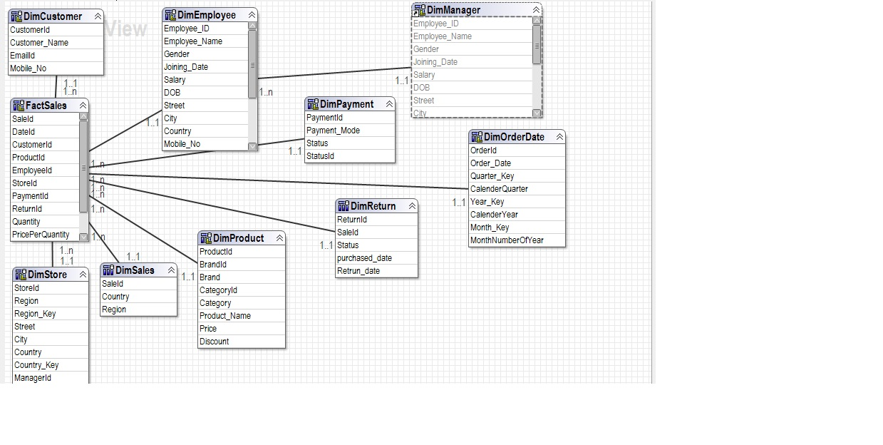
Framework Manager(Physical View)

Slide 11

LOGIN PAGE REPORT

Slide 12
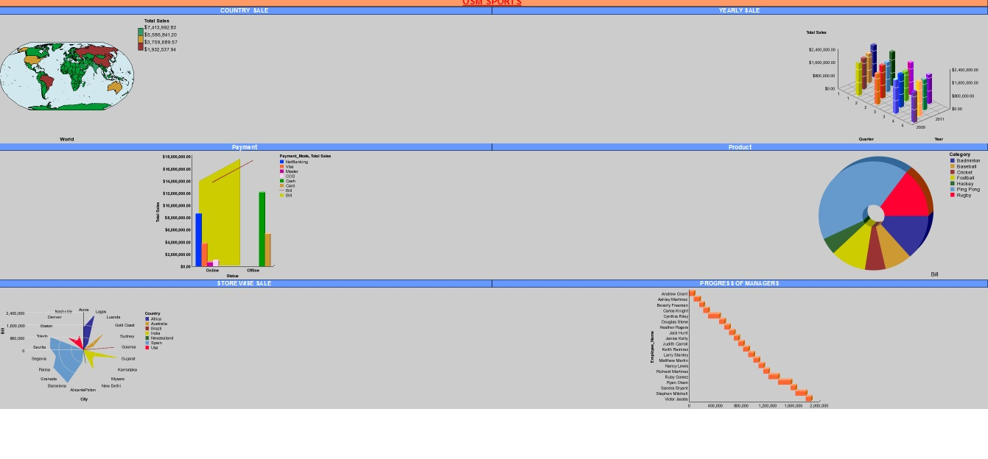
CEO DASHBOARD REPORT

Slide 13

MAIN PAGE REPORT

Slide 14
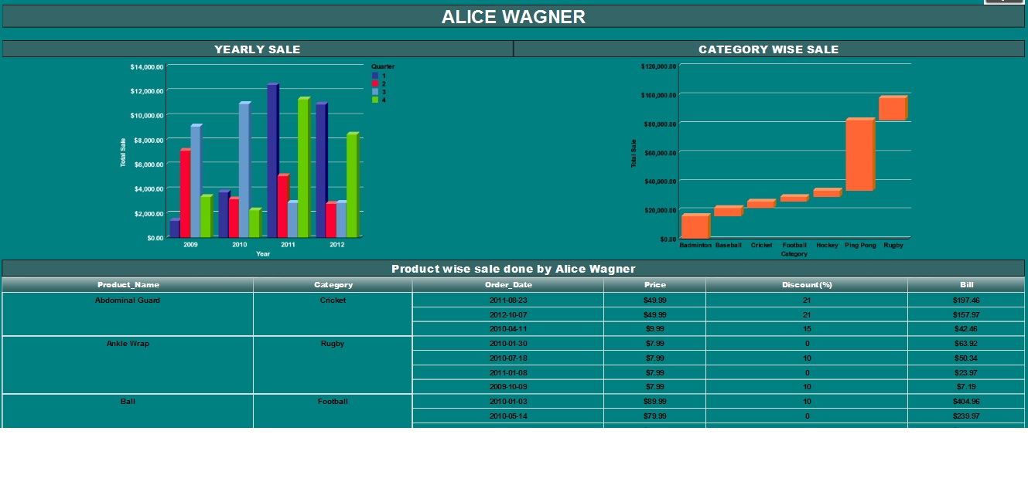
FINAL EMPLOYEE REPORT

Slide 15
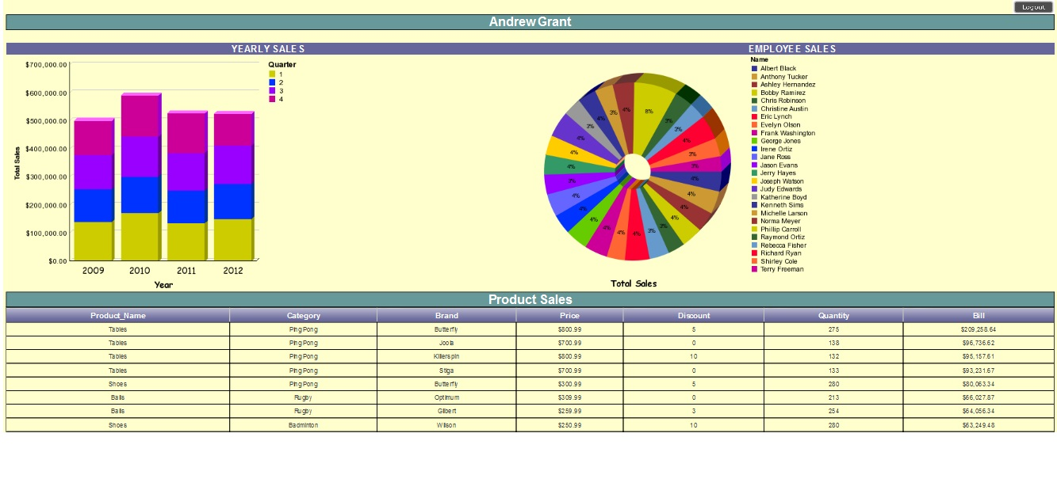
FINAL MANAGER DASHBOARD REPORT

Slide 16
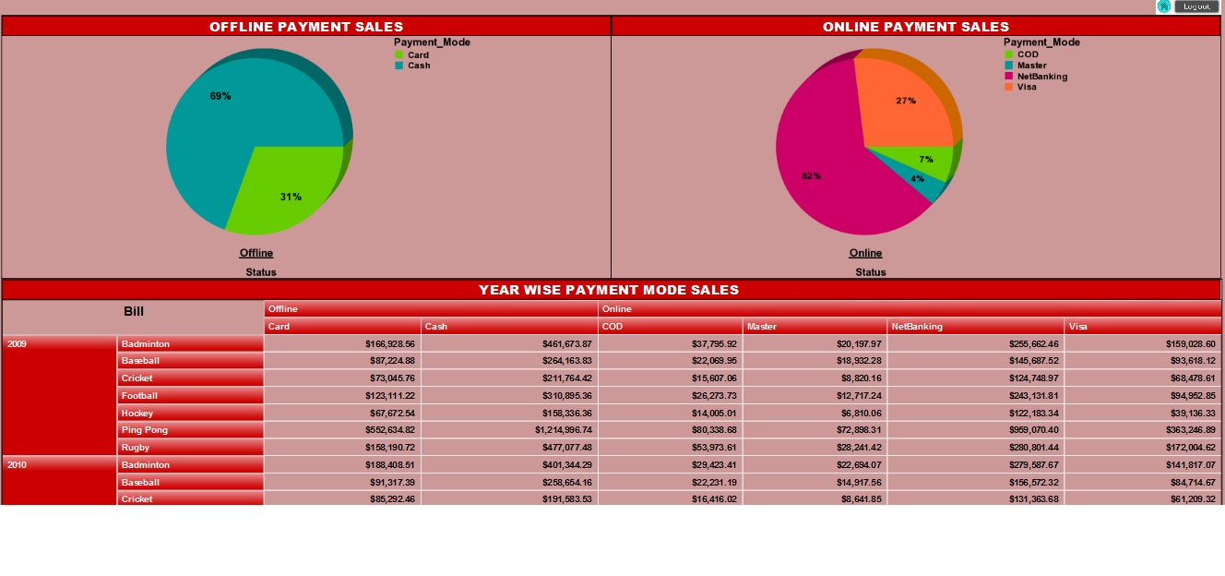
FINAL PAYMENT REPORT

Slide 17
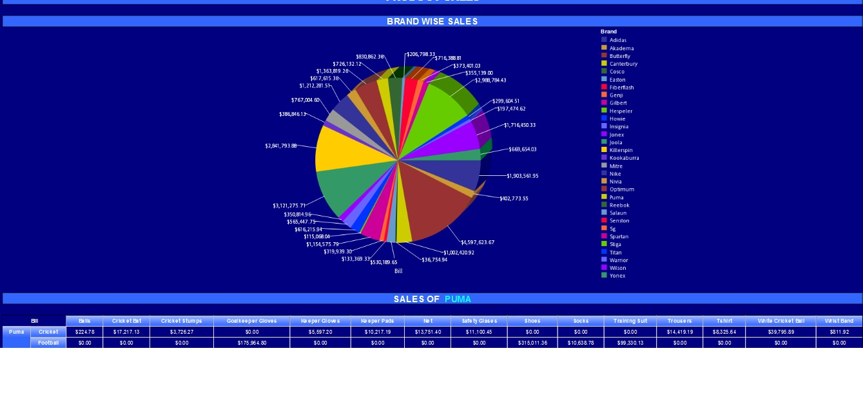
FINAL PRODUCT REPORT

Slide 18
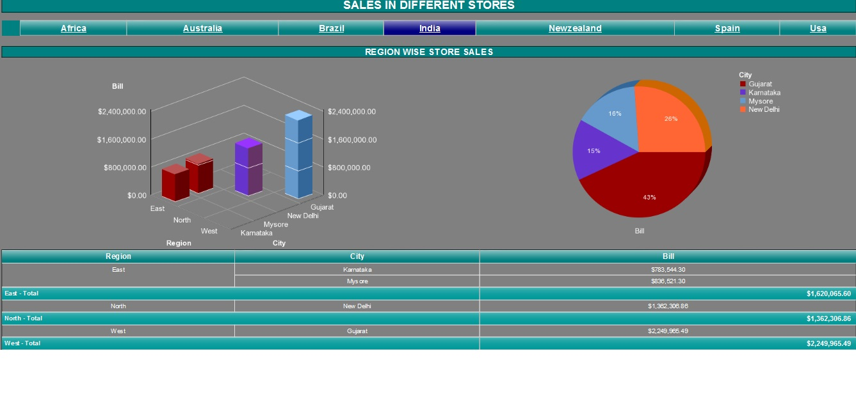
FINAL STORE REPORT

Slide 19
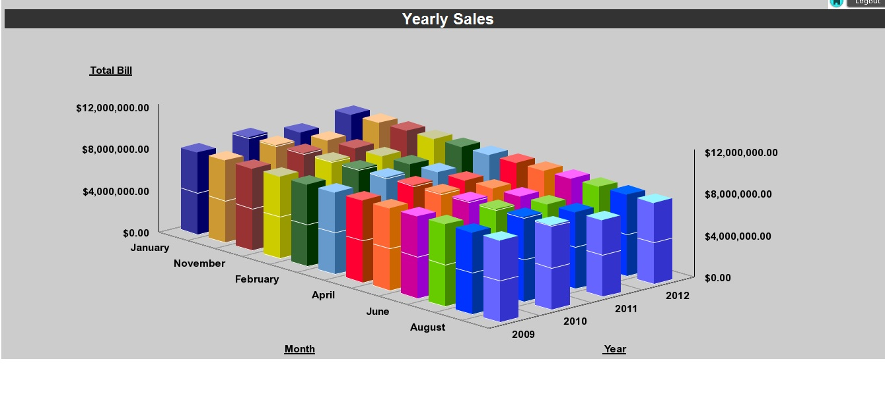
FINAL YEARLY REPORT

Slide 20
Results
Summing up all in a nutshell, it is quite clear that BI will play an integral and indispensable role in the IT industry in the near future. Data analysis with the help of BI tools can help predict future trends effectively and efficiently.
The outcome of the project is that business intelligence has potential to serve as the one stop shop web based information system with the functionality to retrieve, and share selected statistical data/indicators

Slide 21
References
http://etl-tools.info/informatica/tutorial.html
http://www.cognos-bi.info/tutorial.html
https://en.wikipedia.org/wiki/Business_intelligence
https://www.informatica.com/in/products/data-quality.html
http://www.folkstalk.com/2011/12/transformations-in-informatica-9.html

Slide 22
THANK YOU

